Slide 1

A Periodic Table
of polyform puzzles
Prepared by Kate Jones
for G4G Celebration of Mind
Presented March 21, 2021
Virtual to the World

Slide 2
Polyform puzzles are a unique branch of tilings—
Composed of one basic shape to form large compilings.
From Singularity to Infinity, ever more shapes they will take
And, like wallpaper patterns, repeating designs they will make.
Many such tessellations exist, “playable art” by the score.
Here are a dozen—let’s explore these some more.
Top row: Square (polyominoes), cube (polycubes), equilateral triangle (polyiamonds), hexagon (polyhexes), right triangle (polytans), golden triangles (polyores)
Bottom row: Rhombus (polyrhombs), Rombix (polyrombiks), Hopscotch squares (polyhops), Roundominoes (polyrounds), ChooChooLoops (polybends), Ochominoes (polyocts).

Slide 3
…polyominoes
Explored and named and documented in 1953
By a young Solomon Golomb—a math student was he—
Each size has its own name; the best-known are the fives.
Solving Sol’s “pentominoes” adds much pleasure to our lives.
Here are the smallest, from 1 to 5 squares neatly built,
Each a new shape—assembling them will make you skilled.

Slide 4
The more squares we join, the more shapes will form.
Each level grows to evolve its own quorum—
You can’t predict how many: each builds on the previous. Combinatorics can be so devious.
There is no end—Infinity’s the limit.
For playable fun, to human size let’s trim it.
Here’s how many, from size 1 to 8, computers define:
1, 1, 2, 5, 12, 35, 108 and 369.
They’re scaled to combine or to stay single
Or in gigantic solutions freely to mingle.
Each level has its specific name: Monomino, Domino, Tromino, Tetromino, Pentomino, Hexomino, Heptomino, Octomino

Slide 5
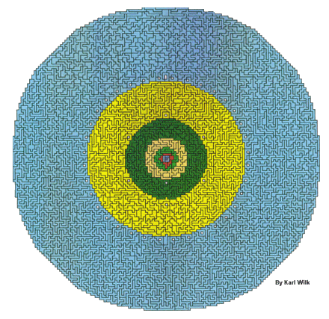
This one includes all polyominoes
from sizes
one to nine.
Karl Wilk, its solver, named it Cyclops—a great design!
Not many people would have the patience
To wrestle solutions
from such inflations.

Slide 6
… polycubes—“Quintillions®”
Not merely squares, but cubes, fantastic figures make.
The pentacubes, both flat and stacked, good thinking take,
Their 29 strange shapes in countless patterns to connect
While hexacubes, all 166 of them, a giant cube erect.

Slide 7
… the Hexacube (10x10x10)
The Hexacube we craft from wood. Its pieces will amaze.
Its treasure chest unfolds on hinges in 11 different ways.

Slide 8
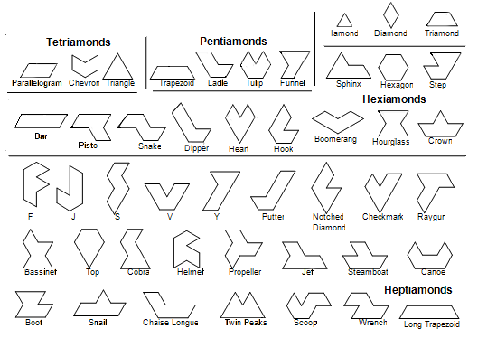
… polyiamonds
Triangles of equal size, equal lengths and equal angles,
Join two or more that fit precisely in intricate tangles.
Two triangles a diamond make,
From which these tiles their family name take.
Top right: “Iamond” (single triangle), Diamond, Triamond (3 triangles). From above left: 3 tetriamonds, 4 pentiamonds, 12 hexiamonds, 24 heptiamonds. Each tile is unique.

Slide 9

… Iamond HexTM, Iamond RingTM, Octiamond RingTM
Two sets in framed trays run the distance
From 1 to 8 triangles, each piece an instance
Of a different shape, each size by hue encoded
And scaled to mix and match as challenges are loaded.
One little subset in round tray is just the sixes,
A stand-alone so hard, you’ll marvel at its trickses.

Slide 10
… polyhexes
Hexagons from 1 to 6 like beehives cluster,
Their perfect patterns please with shapes and luster.
Hundreds of figures to solve, then play the games
And smile when you see how letters are their names.
Top row, left to right: 1 monohex, 1 dihex, 3 trihexes, 7 tetrahexes. Second and third row: 22 pentahexes. Next page: The 82 hexahexes.

Slide 11
… HexnutTM and HexnutTM II
Majestic hexagons like precious art are framed in trays
So that each solution your success and skill displays.
Scaled to each other, mix and match them …
The copious booklet’s full of figures—can you catch them?
Above: Polyhexes 1 to 5.
Right: The 82 hexahexes. See the tile with unfillable hole as a nice centerpiece.

Slide 12
… polytans
Built of half squares like tangram’s famous pieces,
Their numbers can go on forever—the math never ceases.
We only go from 1 to 6, just look at their proliferation—
These are among our toughest puzzles, no exaggeration.
First row: 2 monotans (we throw in an extra one), 3 ditans, 4 tritans.
Rows 2-3: 14 tetratans. Rows 4-6: 30 pentatans. Next page: 107 hexatans.

Slide 13
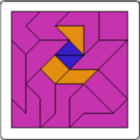
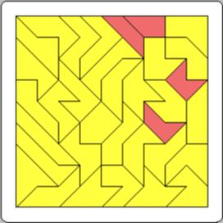
… Tan TricksTM I, II, and III
For centuries a mere 7 pieces kept the world amused
With countless shapes to challenge and leave them enthused. As isosceles right triangles these pieces are well-known.
With 107 pieces, though, an answer is seldom shown.
Better start with the smaller sets, Tan Tricks I and II,
From 1 to 5 they start out easy—the small ones you can do.
Left: Monotans, ditans, tetratans.
Center: Tritans, pentatans.
Right: Hexatans with one free space. (This one took 45 hours to solve.) All are size-compatible.

Slide 14
… polyores
Their name refers to “gold” as in the ratio,
That decimal of endless numbers in a row.
Two different triangles are perfect shapes to form
In twos and threes this esoteric swarm.
Jacques Ferroul defined this strangely beautiful set;
With some or all a regular pentagon you get.

Slide 15
… La Ora SteloTM
Now see this perfect star at left below,
Wherein all triangles their ratio show.
Then marvel at the full-size pentagon at right—
Can you separate the blues and white?

Slide 16
… polyrhombs
Diamonds of four equal lengths of side,
In this case two equilateral triangles wide,
Join in pairs and trios, colored to form dice.
Their optical illusions of cubes are really nice.
Above: the tiles sizes 1, 2, and 3 rhombs of the CubitsTM set, with all combinations of shapes and color patterns to form the cubic star at left, the ring at right, and hundreds of other cube-colored figures.

Slide 17
… polyrombiks
Dissect a convex polygon with even numbers of sides With parallel lines into all the rhombuses it hides
And find it yields, in singles and all possible pairs,
Exactly the pieces needed to fill out the original shares.
”Rhombic circle tilings”, inventor Alan Schoen declares,
“Are a universal principle, at any scale one dares.”
Upper left: A16-sided polygon yields 4 “keystone” single sizes with, respectively, 22.5, 45, 67.5, and 90-degree angles. Upper right and bottom row:
Pair them in every possible concave way and get 12 rombiks twin tiles.
The 16 pieces can form the original polygon in thousands of ways and win smiles.

Slide 18
… Rombix® Jr., Rombix®, Rainbow Rombix®
Now see the underpinning geometric laws at play:
The number of sides affects how many keystones array.
The number of keystones the number of colors ordains,
Each color the same supply of rhombs obtains.
This unique mathematical phenomenon you’ll see
All the way out from one to infinity.
They all have ladders, top to bottom.
Even the smallest one has got ’em.
Left: Rombix Jr., 2 singles, 2 twins in each of 4 colors (makes 4 little octagons).
Center: Rombix, 4 keystones, 16 sides. Right: Rainbow Rombix, 6 keystones

Slide 19
… polyhops
The classic hopscotch pattern’s staggered squares
In each row slide by half a space, like stairs.
Here is the set, with 1, 2, 3, and 4 squares built.
Each size has its own color and a dizzying tilt.

Slide 20
… HopscotchTM set
See now the grid, like brickwork on a hill,
That undergirds each fascinating figure’s fill.
What’s tricky here is that each piece must remain
In horizontal mode, a challenge for your eye and brain.

Slide 21
… polyrounds
Let’s fill a square with circles, then you’ll notice
How between the circles the opening bowed is.
Let’s make those into “bridges” joining 2 or 3 or 4,
Each shape has its own color, of each, one or more.
Left: Roundominoes®, 28 pieces, sizes 1-3. Center: Super Roundominoes®, 43 pieces, sizes 1-4. Right: Grand Roundominoes®, 83 pieces, sizes 1-5.

Slide 22
… polybends
Cut a doughnut in 4 wedges,
Join those arcs by their edges.
Place them to build loopy tracks.
Symmetries make you relax.
Four sizes, each in its own hue
Encloses islands. Can you do?
Above: The 16 pieces of ChooChooLoopsTM in all combinations of 1 to 4 quarter-ring segments, curving in and out.

Slide 23
… polyocts
Two octagons join up, like figure 8’s as pairs.
Now give each pair, from zero to six, some little squares
To help make corners—24 all-different tiles can fill
The plane with colors separated, as you will,
Or color groupings, neighborly affection,
A work of art, each pattern’s a confection!
OCHOMINOES

Slide 24
… OchominoesTM, Triangule-8TM, DorisTM
To tile the plane with octagons and leave no hole,
You need those many squares to play a helping role. These three treat octagons in different styles:
As pairs, triangulated, and edge-colored tiles.
Left: Ochominoes, 24 diocts with 0 to 6 squares per tile. Center: Triangule-8, 20 Euler-style triangulated octagons with 12 square islands to form the lattice. Right: Doris, 24 all-different octagons inlaid with every combination of 3 edge colors to match their neighbors, with 16 built-in square islands.

Slide 25
Conclusion
This enumeration is not the fullest score.
Geometry leaves lots more of every level to explore.
The essence is to find a starting point and grow,
Expanding ever up and outward by algorithmic flow.

Slide 26
Each chain becomes a Universe, a periodic drive,
Ascending and continuous, its energy alive.
Each step combines from previous stages—evolution’s code,
And at each step we can dissect it back to its first node.

Slide 27
Something there is in human minds that cherishes the new,
That sees the beauty of emerging order, that it’s good and true.
That’s how we build a consciousness, no end in sight,
And how we build the future in growing wisdom’s light.

Slide 28
Every singularity longs for an endless goal,
So mathematics models the Universe’s soul.
Now let us trace one further, wider megathought above
And call the Universe’s combinatorial joinings—love.

Slide 29

Music composed and played by Sergei Novikov www.SpeakingMusic.com
For a PDF copy of this presentation, visit www.gamepuzzles.com/periodic.pdf
for the joy of thinking
© 2020 Kadon Enterprises, Inc.
Since 1979
kadon@gamepuzzles.com

