Slide 1
35 years of Kadon 75 years of Kate
A few things you may not have known about me.

Slide 2
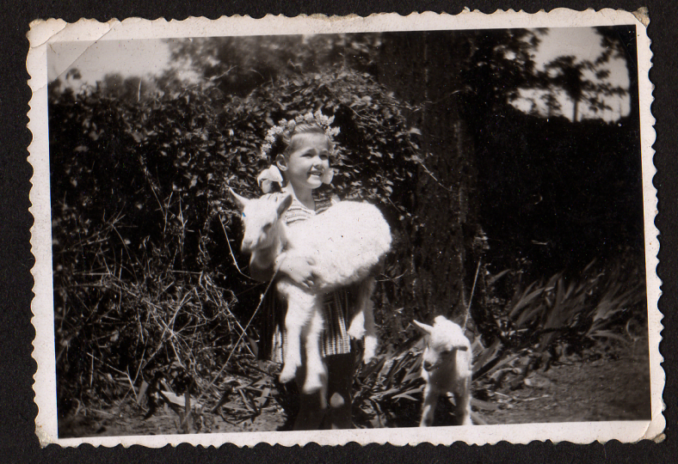
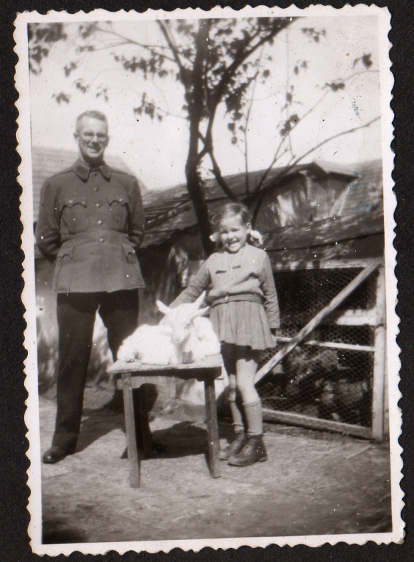
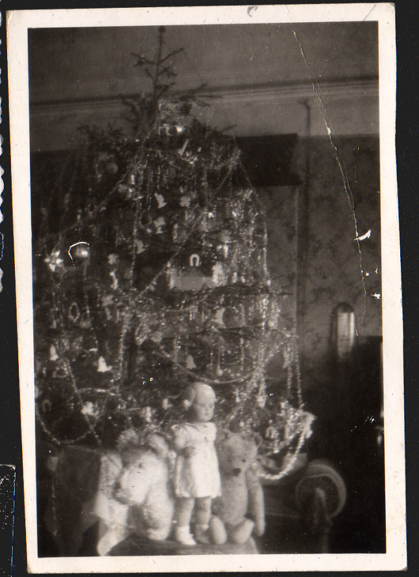
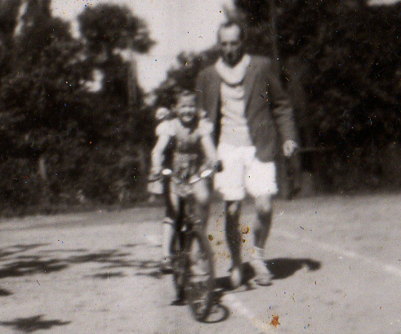
The early years

Slide 3
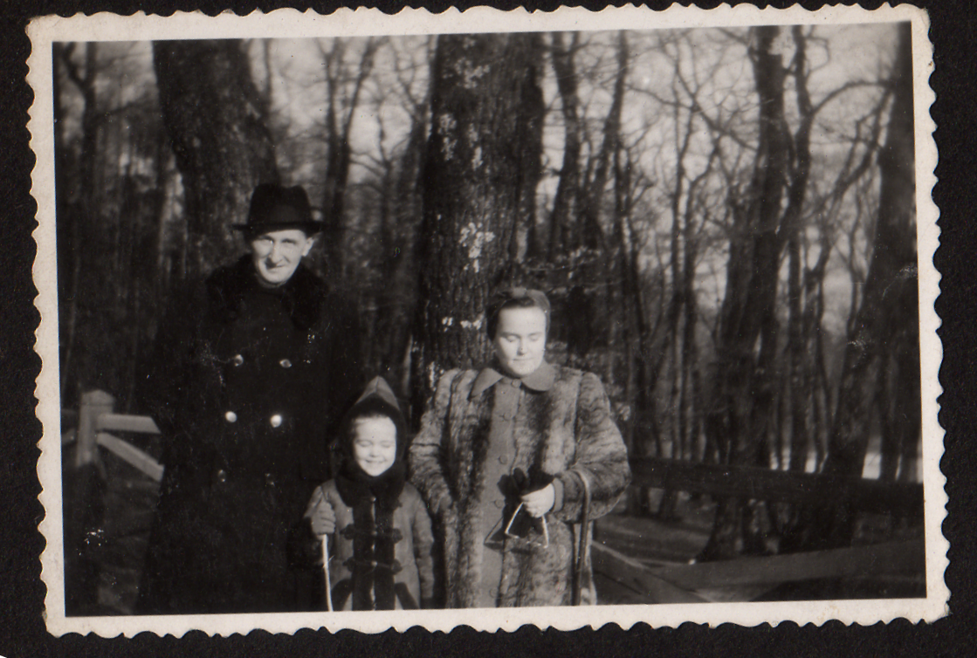
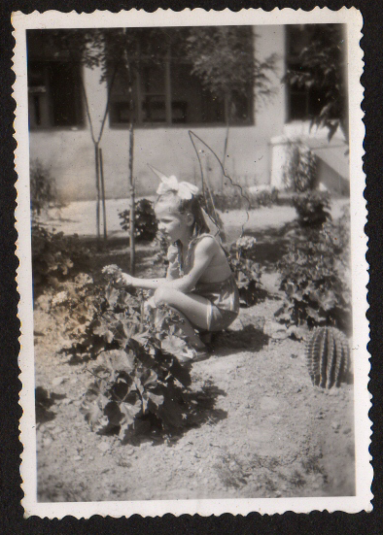
Furry and fairy

Slide 4
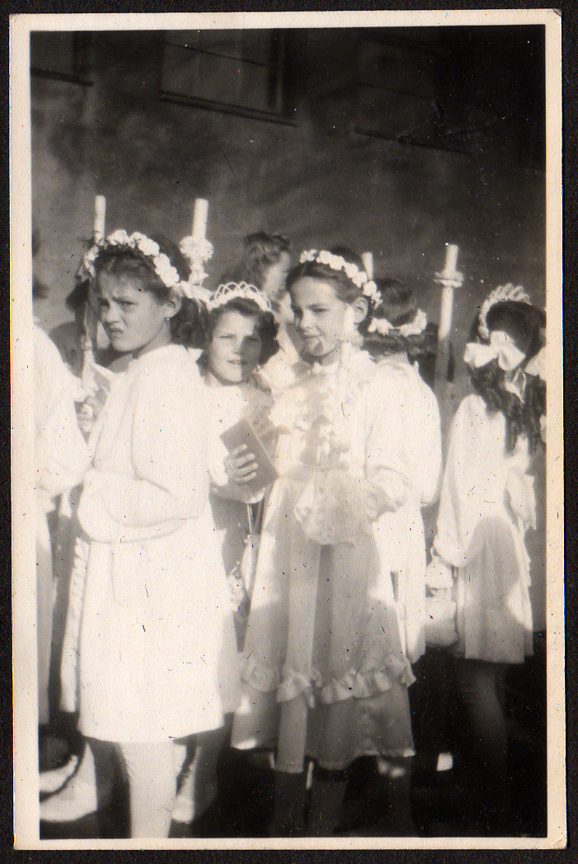
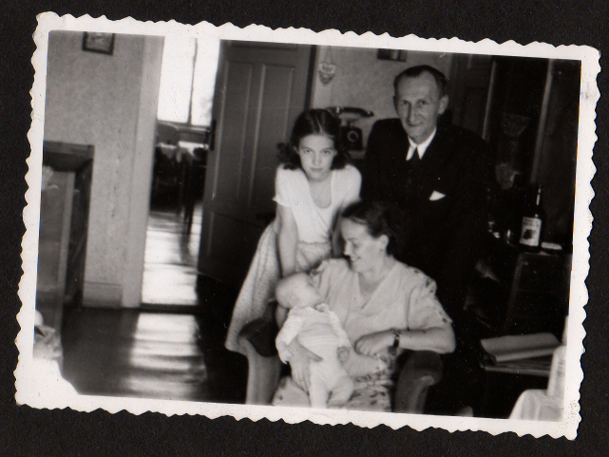
On being 12

Slide 5
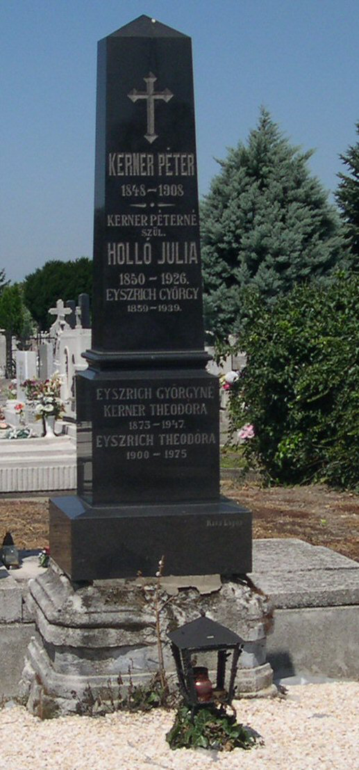
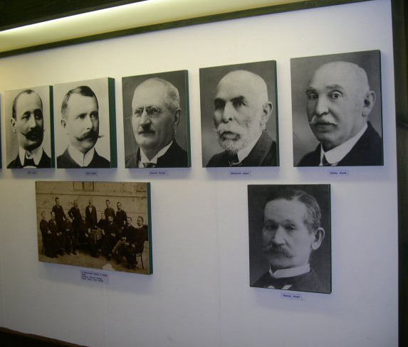
Ancestry - 1859

Slide 6
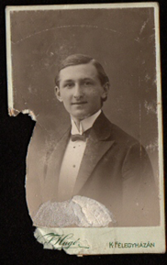
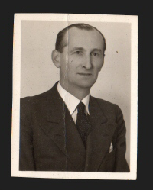
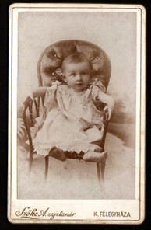
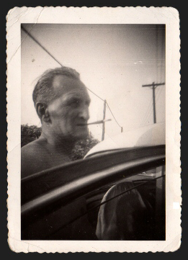
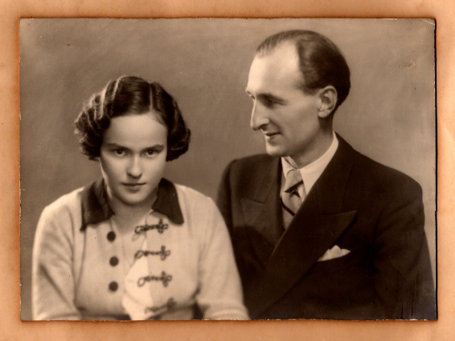
Progenitors

Slide 7
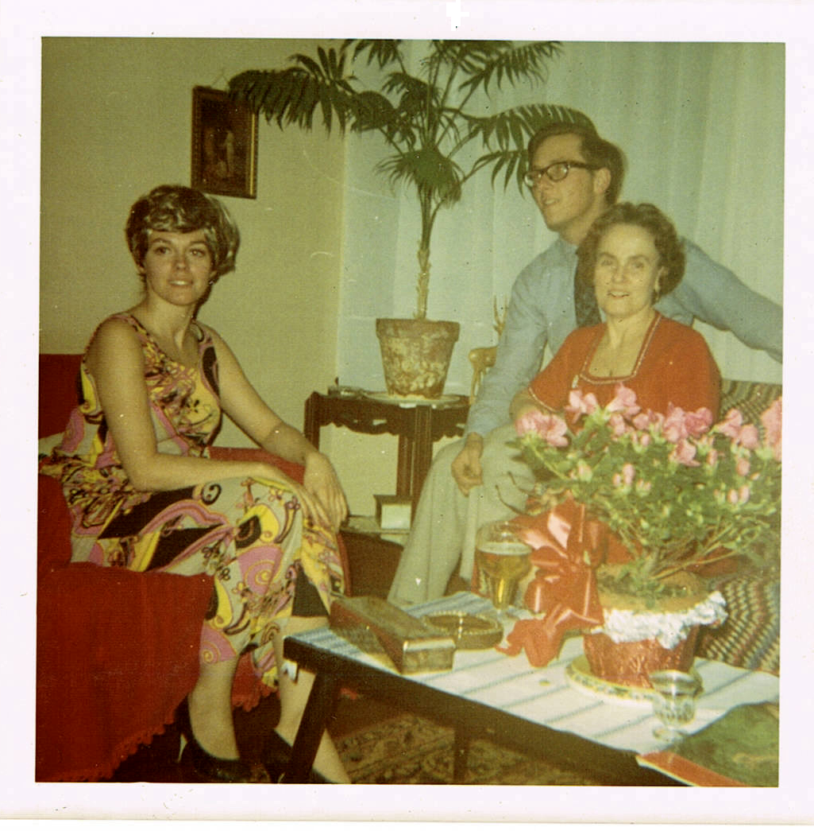
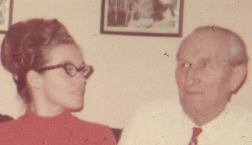
Grown up

Slide 8
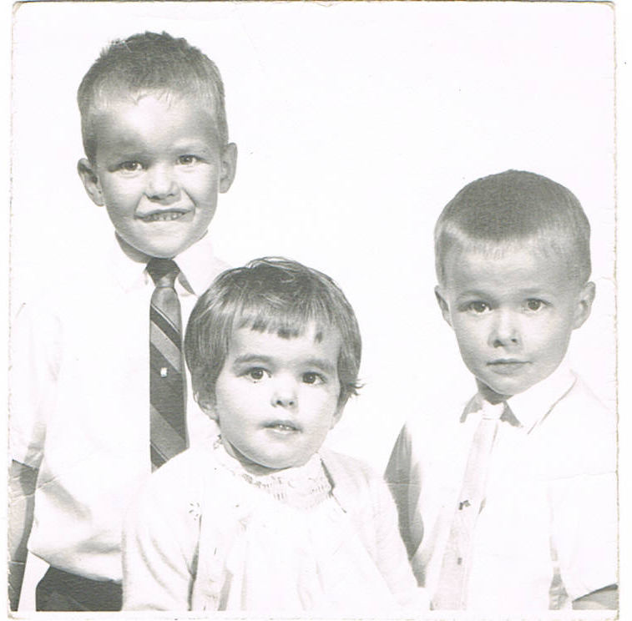
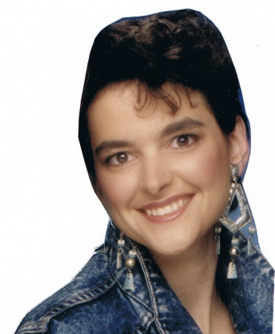
Life goes on

Slide 9
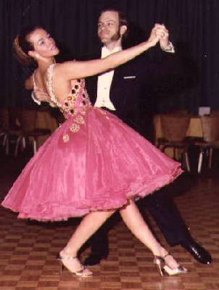
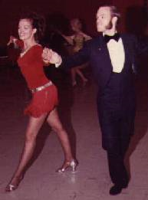
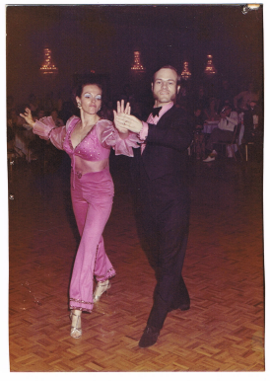
The dancing years

Slide 10
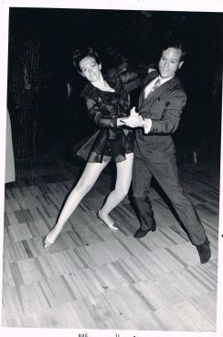
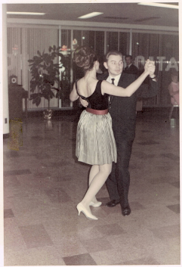
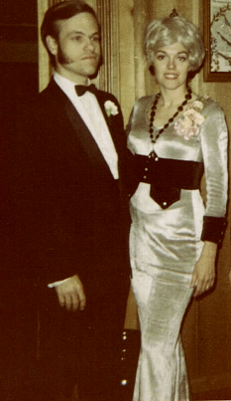
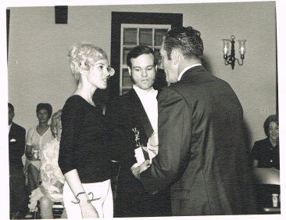
Competitions

Slide 11
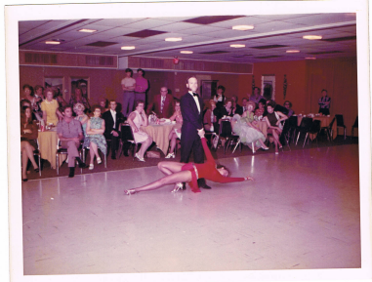
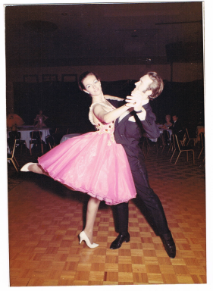
Exhibitions

Slide 12
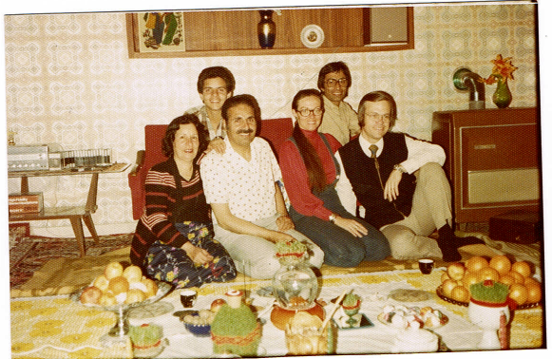
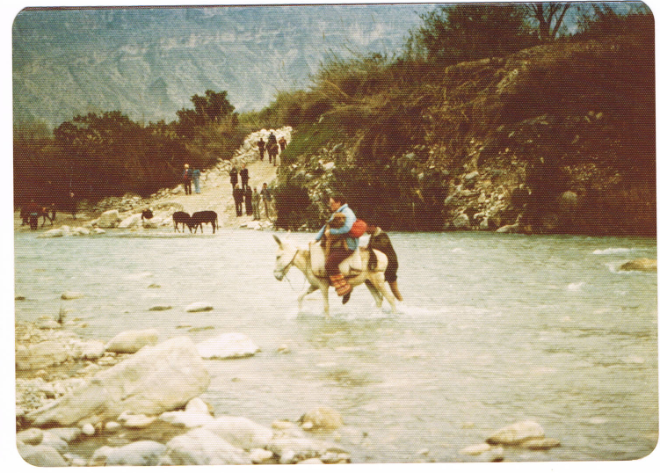
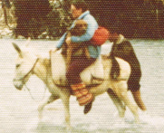
The Iranian interlude

Slide 13
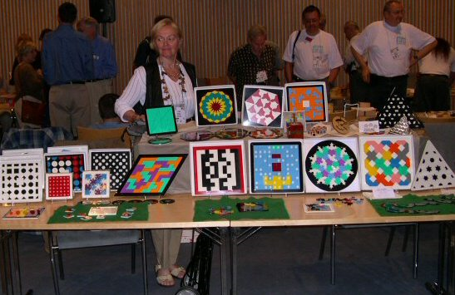
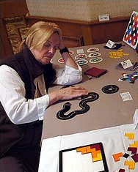
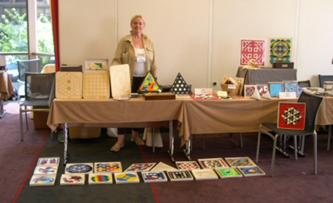
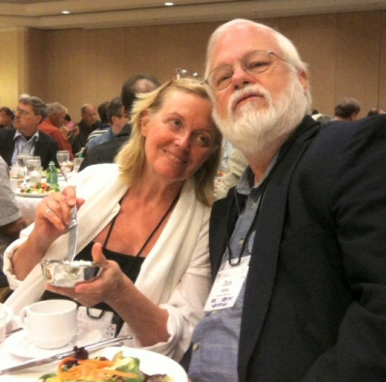
The puzzle treks

Slide 14
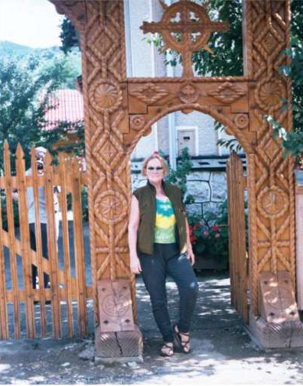
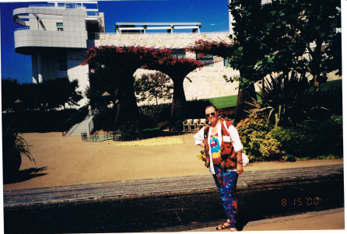
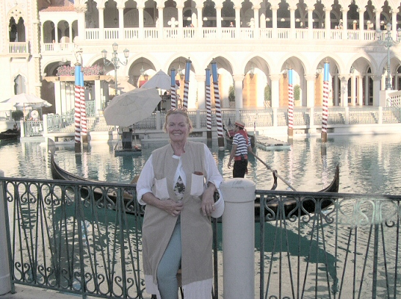
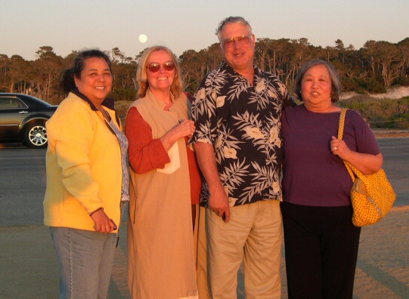
Travels

Slide 15
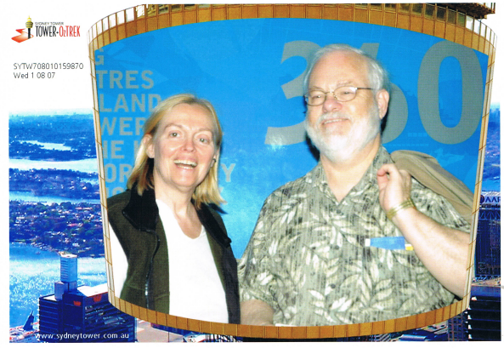
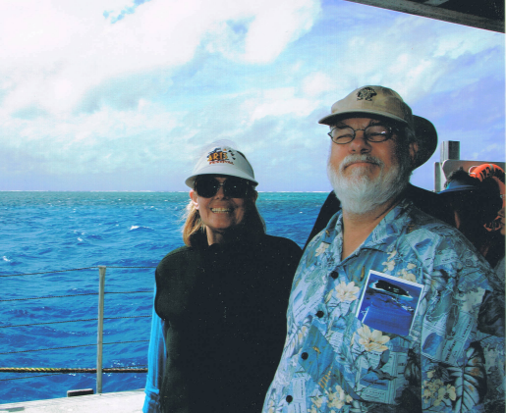
Downunder

Slide 16
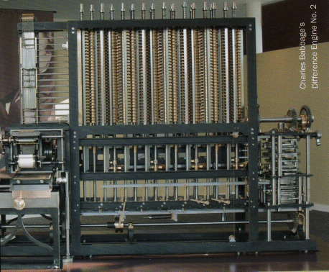
For the geeks
A working Babbage machine

Slide 17
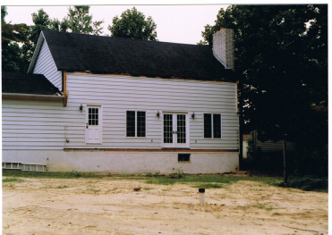
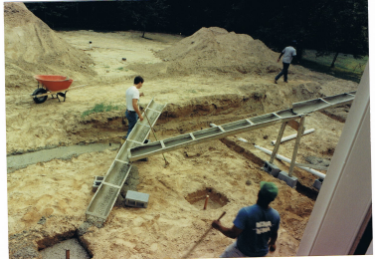
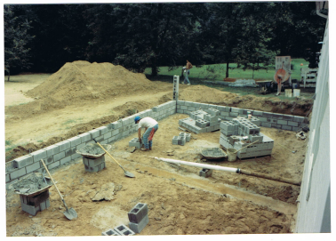
The house expansion

Slide 18
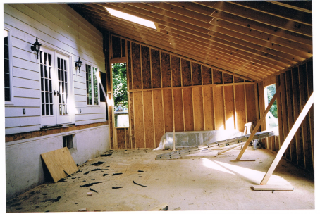
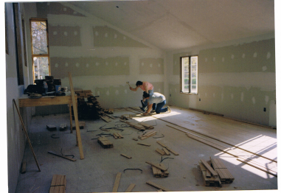
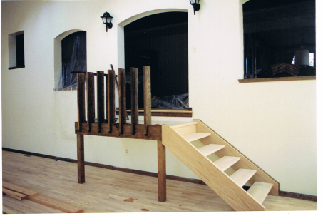
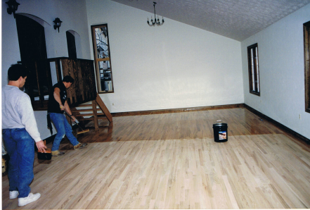

Slide 19
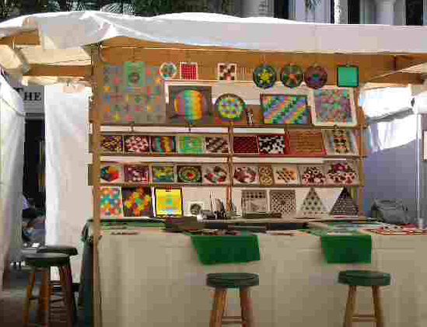
Out on the road

Slide 20
… in all kinds of weather

Slide 21
… and indoors, too

Slide 22
Fame
The “Games 100” selections:

Slide 23
Renaissance! Old and new

Slide 24
Enter, m’lords and ladies…

Slide 25
Our game master and mistress

Slide 26
Celebrations

Slide 27
The Gamery’s 30 years …
and Kadon’s 35th
We’re glad you’re here!

Slide 28
The people
Our deepest gratitude to all the individuals who have helped us get through these 3.5 decades—through work, purchases, praise, and friendship. You know and we know who you are.
Worker bees:
Josiane Smith * Jack Acly * Anna Stephan *
Rita Krauth * Thomas Atkinson * Penny Burke * Meshele Merchant * Marilyn Mabe * Eric Bare * Richard Grainger * Dick Jones
Former bees:
Fabian * Julie Stevens * Violet Carberry LeVoit * Chuck
Coates * Michael Keller * Chris Palmer * Ward Hollins *

Slide 29
Sirs and Mistresses
Renaissance:
Art Blumberg * Rolinda Collinson * Eileen Shaivitz * Steve Zeve * Meshele Merchant * Thomas Atkinson * Eric Bare * Anna Stephan * Richard Grainger * Dick Jones * Lady Katrina
Former squires:
Daniel Austin * Ken Isbell * Cassandra Stevens *

Slide 30
In memoriam
Dave Smith * Bob Steinberger * Charles Titus * Burt Hochberg * Robin King * Martin Gardner * Arthur C. Clarke * Wade Philpott * Anatol Holt * Michael Waitsman * Rich Maiers

Slide 31
The inventors
Kadon publishes some wonderful games that we developed from the creations of other kindred spirits. These 41 folks get royalties. They are all listed in the website.
Charles Butler * Phil Chase * Christopher Clark * Jeff Dender * Daniel Erdely * Jerry Farrell * Jacques Ferroul * Beverly Johnson * Manuel Garcia * Serhij Grabarchuk * Richard Grainger * Sjaak Griffioen * Ward Hollis * Glenn Iba * Scott Kim * Alan Kross-Vinson * Henry Kwok * Jacob Lettie * Joe Marasco * William Rex Marshall * Oriel Maxime * Dwayne Mears * Christian Freeling * Henrik Morast * Don O’Brien * Ferenc Palinkas * Myra Philpott * Henri Picciotto * John Ring * Mike Roberts * Rombix USA * Irene Schensted * Liane Sebastian * Stephen Sniderman * Norton Starr * Devin Stewart * Terry Titus * Anneke Treep * Oskar Van Deventer * Nancy van Schooenderwoert * Dale Walton * Zdravko Zivkovic

Slide 32
The hottest sellers

Slide 33
Our first license
We have several times licensed our trademark, “Blockout,” for software games. Now Brainwright has licensed both Roundominoes and Iamond Hex and produced them in very nice plastic in China. We have some samples here. They are to be marketed in bookstores and other intellectually appealing outlets starting in 2014. Check them out. This is just a start.

Slide 34
The End
Thanks for your attention and for being here
to share this landmark moment with us.
May the adventure of life continue
to be a happy one for you.

