Slide 1
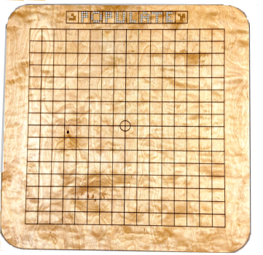
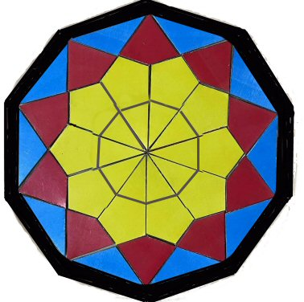
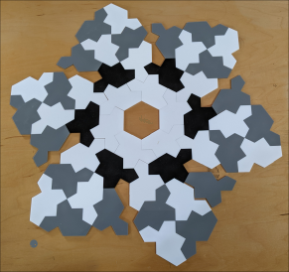
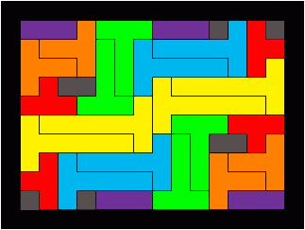
Our World Premieres at G4G15 in 6 minutes by Kate Jones
Inspirations from around the world

Slide 2
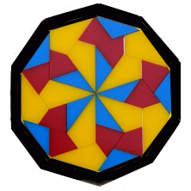

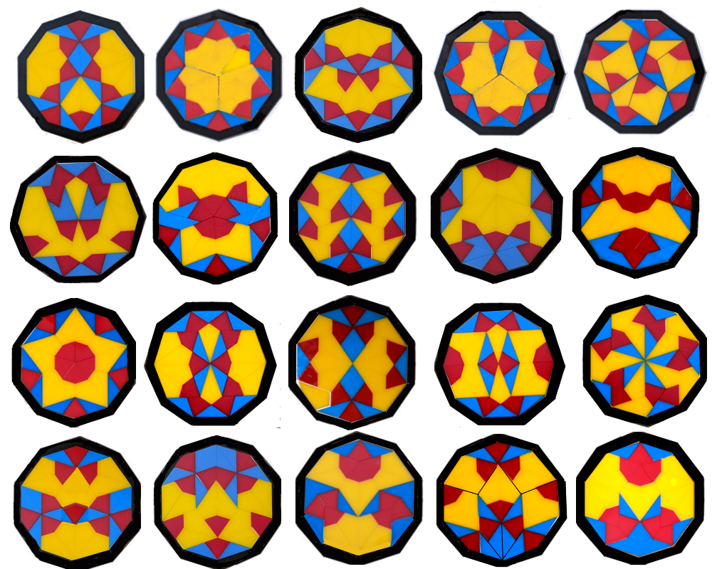
Penta-Mosaik
by Tick Wang
Shanghai
Penta-MosaikTM
Another of the golden ratio clan--
In decagon frame thirty pieces plan
Breathtaking symmetries for you to build.
With each new pattern thrill that you are skilled.
Ten each of kites both short and long appear
As triangles of gold proportions cheer.
Or let them spread in free-form revelry,
Your glorious art displayed for all to see.

Slide 3

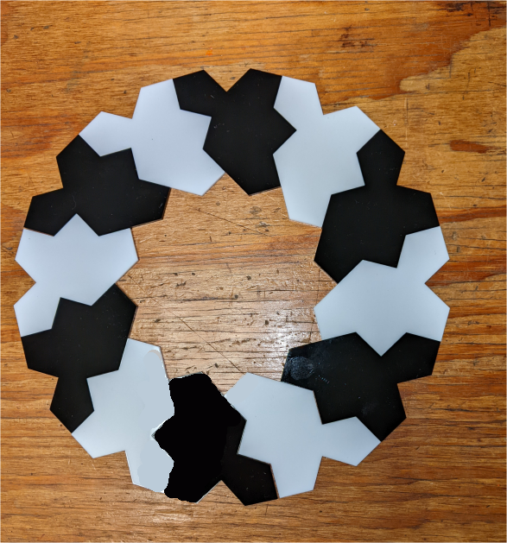

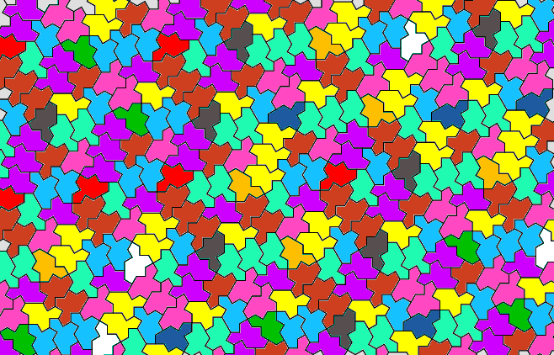
Discovered by David Smith, developed with
Craig Kaplan, Joseph Myers, and
Chaim Goodman-Strauss
OneStoneTM
Through centuries of searching mankind’s lore
To find one shape whose power we explore
To infinitely fill the planar void
Has left astonished solvers overjoyed.
To have produced a tile, first on this earth.
Proves human intellect’s long nourished birth.
Though nonsymmetric, paired it mirrors fair
In endless couplings golden ratio’s share.
Behold the chaos of its free array
Exquisite in kaleidoscopic play.

Slide 4
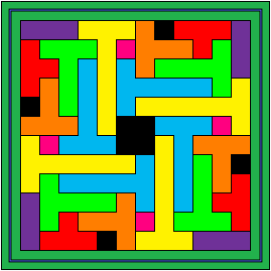
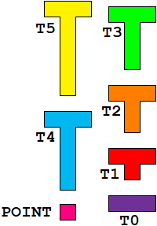
Robert’s T Party
by Robert Vermillion
Maryland
Robert’s T Party TM
With four of every size, tall T’s, short T’s
Can fill their 10 by 14 tray with ease.
Their legs have grown from nought to five,
Their sizes marking the full color hive.
Joined or divided, symmetric or not,
Each challenge offers a suspenseful plot.

Slide 5
PopulateTM
Created by Elijah Allen
Texas and Maryland
PopulateTM
    Four chessboards join to form a vast terrain
    Where sixteen cells by sixteen cells obtain.
    The complex rules take many steps to match
    While some conditions on the board will hatch
    Constructive and destructive dice-rolled powers
    As luck and losses hit the board in showers.
    It pays to be good neighbors in defense.
    Teamwork always makes the better sense.

Slide 6
Antiquities
Perplexing Poultry — 4 archival sets
Thank you!
kadon@gamepuzzles.com
www.gamepuzzles.com

